Slide 1


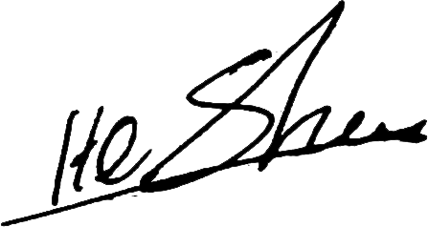


QUANTUM BLAZE
UPDATE INVOICE
SOFTWARE SOLUTION
ORDER NUMBER
#000002
FROM:
INVOICE TO:
QUANTUM BLAZE Software Solution
quantumblazesoftwaresolution@gmail.com
Milani Wijewardhana
Ayusha Pharmacy & Grocery,
No, 55 /1/2, welikadamulla, Attanagalla.
INVOICE DATE:
05 Aug, 2025
Date | Description | Version | Rate (Rs) | QTY | Dis % | Amount (Rs) | Paid
2025-06-27 | Printer configuration | 1.0.1 | 2,500.00 | 1 | 100% | 0.00 | ✔
2025-07-03 | Invoice bill design & Product Registration design changes | 1.0.2 | 6,400.00 | 1 | 100% | 0.00 | ✔
2025-07-21 | Table improvement [product list] | 1.0.3 | 0.00 | 1 | 100% | 0.00 | ✔
2025-07-26 | Table improvement [product list, and 3 reports] | 1.0.4 | 12,500.00 | 1 | 100% | 0.00 | ✔
2025-08-05 | Typing quantities and adding bill discounts manually | 1.0.5 | 8,000.00 | 1 | 0% | 8,000.00 | ✔
Sub Total
LKR: 8,000.00
Paid Amount
LKR: 8,000.00
Payable Amount
LKR: 0.00
……………………………
……………………………
Provider
Client
For any inquiries or assistance, please reach out to us at:
quantumblazesoftwarsolution@gmail.com
071 989 2932 / 071 968 1816

